Slide 1
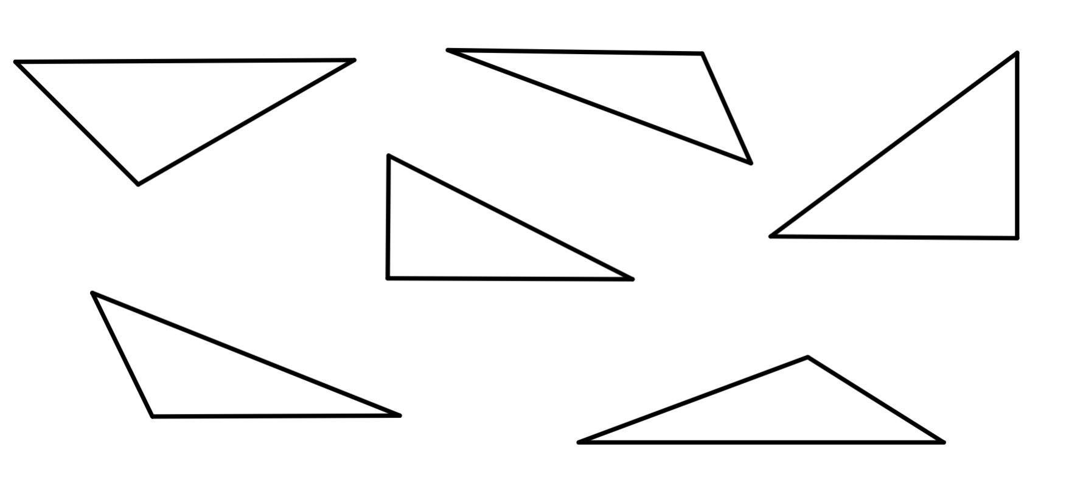

Checking understanding of perimeter
Task A: Understanding perimeter
1) Find the perimeter of each shape.
a)
b)
3 m
c)
5 m
4 m
5 m
4 m
5 m
3 m
3 m
1 cm
12 m
16 m
1 cm
18 cm
2) Tick the triangles that contain enough information to calculate their perimeter by summing the given lengths. All lengths are given in centimetres.
5
4
B
2
5
A
5
D
3
2.5
4
2
C
4
4
3
4
3
E
F
2
5

Slide 2
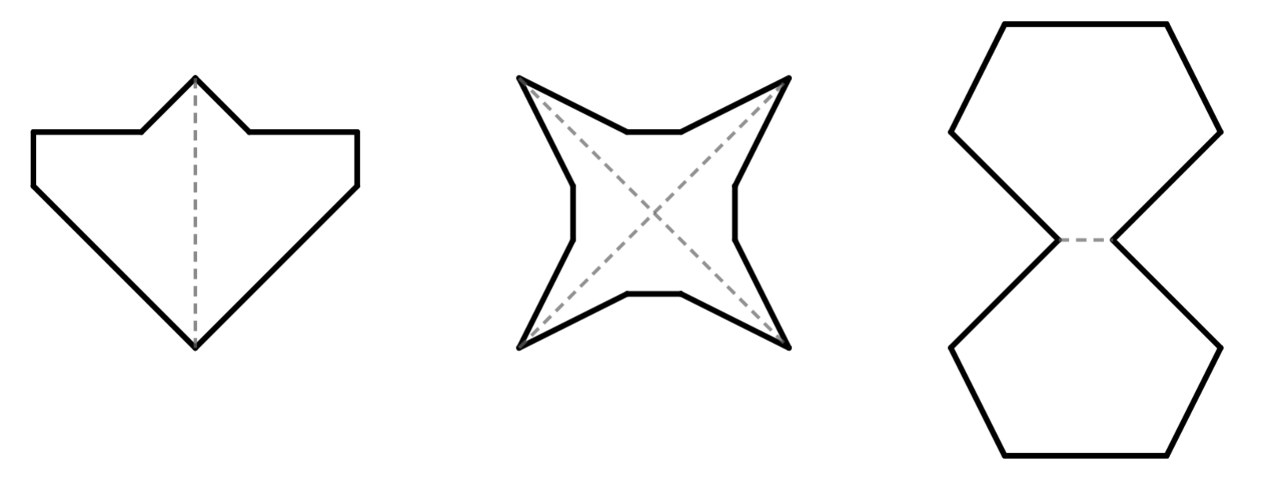
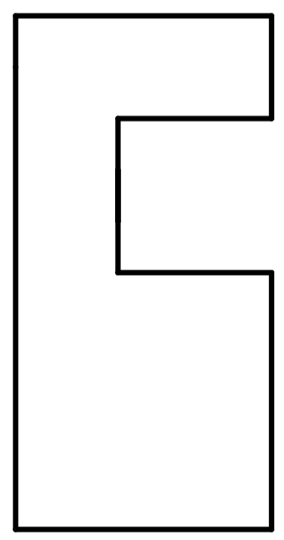
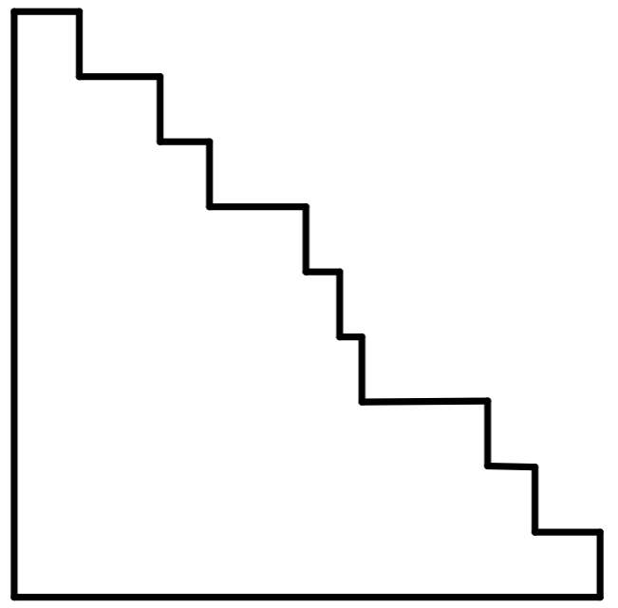
Checking understanding of perimeter
Task B: Finding efficient methods to calculate perimeter
1) The shapes were formed by reflecting line segments over the dashed mirror lines. Find the perimeter of each shape.
a)
1 m
b)
5 cm
5 cm
2 m
1 m
4 m
2 cm
P = 16 m
P = 48 cm
2) Find the perimeter of each shape.
a)
b)
c)
11 mm
12 m
5 cm
P = 36 m
P = 20 cm
P = 66 mm
3) Find the perimeter of each composite rectilinear shape. All lengths are given in metres.
a)
b)
3
6
4
11
5
2
P = 40 m
9
P = 40 m

Slide 3
Checking understanding of perimeter
Task C: Finding missing lengths when the perimeter is known
1) The perimeter of each shape is 24 m. Find the value of each of the unknowns.
a)
4 m
b)
b m
7 m
7 m
a m
a = 6
b =
4
c)
9 m
d)
c m
10 m
d m
c = 6
d = 7
e)
e m
f)
f m
5 m
8 m
5 m
6 m
e = 4
f = 1
Mathematics in Education and Industry
v2.3

